Slide 1
Occupancy Modelling
CSP4141
Monday, May 21st, 2018
Intro to Occupancy Modeling
National Conservation Training Center Course
Dr. Reilly & Dr. Shea
May 21st - 25th, 2018
Columbia River Fisheries Program Office

Slide 2
Occupancy Modeling- CSP4141
Introductions
Dr. Michelle Reilly - U.S. Fish & Wildlife Service, Yreka, CA
Dr. Colin Shea - Florida Fish & Wildlife Conservation Commission, St. Petersburg, FL

Slide 3

Student Introductions
Name
Work title/agency/location
Motivation for taking the course
Statistics background or comfort level
Experience with R

Slide 4
Expectations for Class

Slide 5
Objectives:
Upon completion of this course, participants will be able to:
Describe the importance of accounting for imperfect detection when modelling species occurrence
Understand the fundamentals of occupancy survey design
Describe the uses and limitations of single and multi-season occupancy models
Fit single- and multiple-season occupancy models in R using the package unmarked
Understand and interpret parameter estimates from single- and multiple-season models

Slide 6

Questions before we begin?

Slide 7
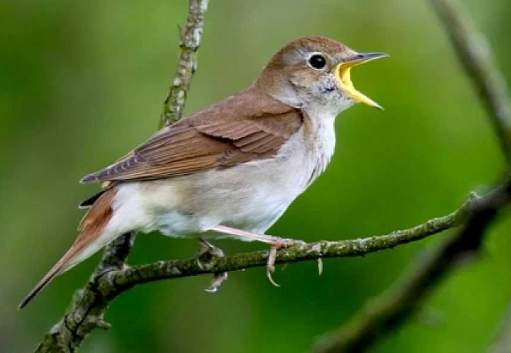
From MacKenzie et al. 2017
“If a bird sings in the forest, but the investigator fails to detect it, is the forest occupied?”
-Evan Cooch

Slide 8

Background/History
Censuses (COMPLETE enumeration) of individuals is rarely attainable
Thus, conclusions about populations must be based on samples.
But not all animals present are exposed to or by sampling.

Slide 9

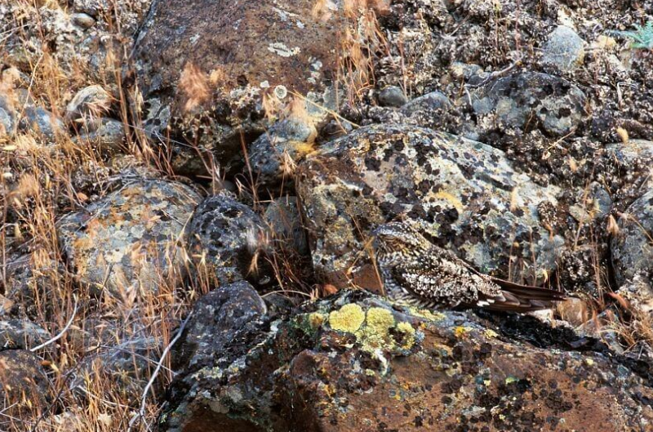

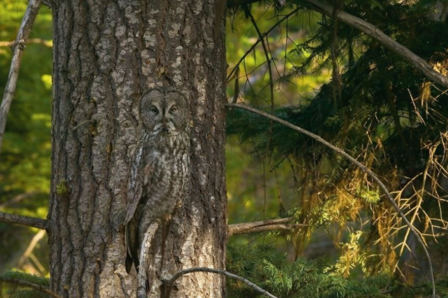
Course Motivation?

Slide 10
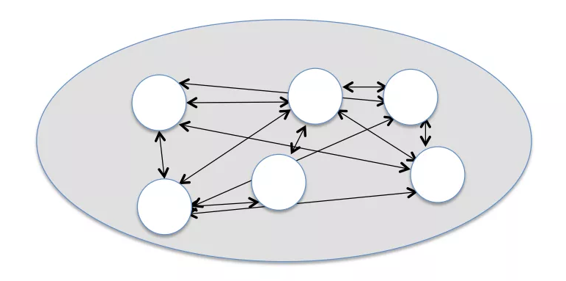
Occurrence
Occurrence-based summaries are widespread in ecology:
Landscape ecology
Levins, 1969
Macroecology
Brown & Maurer, 1989
Metapopulation ecology
Moilanen & Hanski, 1998
Habitat suitability
Boyce & McDonald, 1999
Wildlife ecology
He & Gaston, 2000

Slide 11

Occurrence
Definition: “the occurrence of one or more individuals at some place and time” or “a biological quantity that relates to the presence or absence of the species from a unit during a sampling period.”
State variable (e.g. other include abundance, species richness, etc.)
Binary variable (0,1)
Reduced information version of abundance

Slide 12
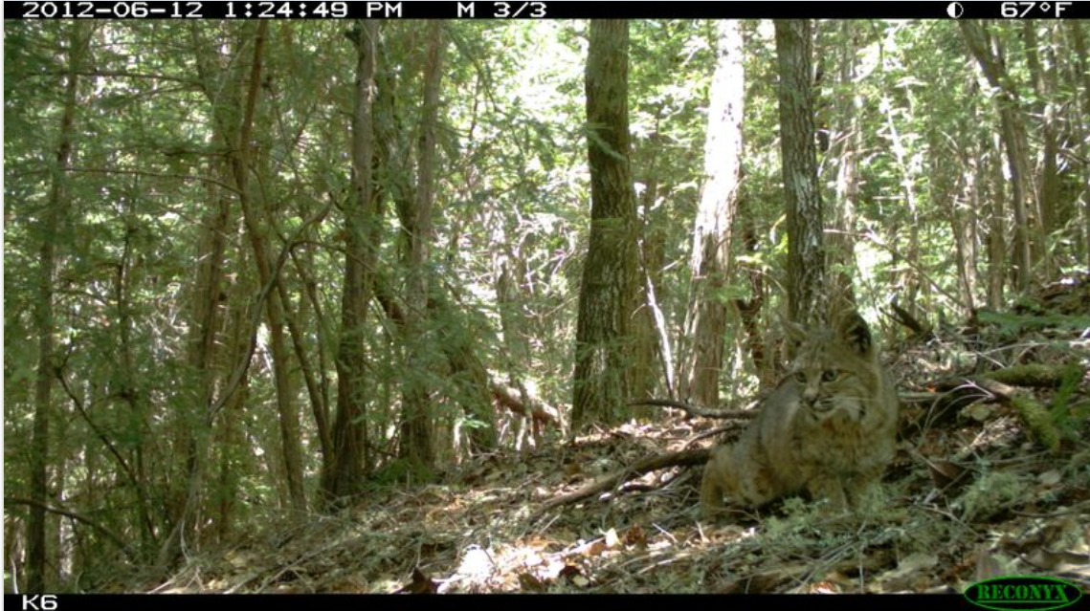
Why use ‘occupancy’ or ‘occurrence’?
When we are unable to mark individuals; or
When the pattern of occurrence is the parameter of interest; or
When the proportion of a study area that is occupied is of interest; or
Association between species occurrence and environment is of interest.

Slide 13
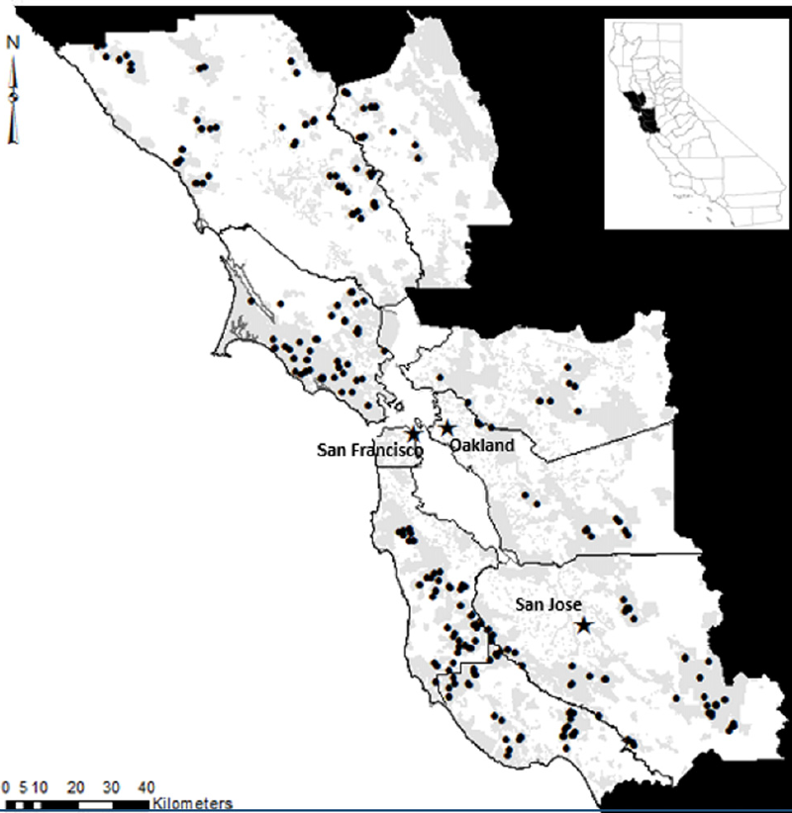
Occupancy as habitat preference
If we can relate occupancy (“probability of a site being occupied by the species”) to covariates that describe the habitat & model of habitat preferences
…then, we can construct maps of probability of occupancy or “distribution”
(e.g., “habitat suitability model”, “species distribution model”, etc. )

Slide 14
Brief Review of Classification of Detection Data
Presence only
“Presence/absence”
“Presence/absence” with time replication
Counts
“Without data, all you are is just another person with an opinion.”

Slide 15
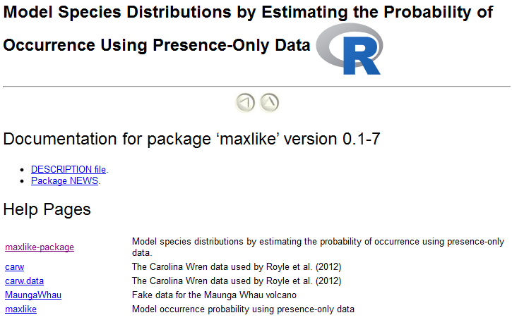
Classification of Detection Data
Presence only
Think museum specimens or other data were absence wasn’t recorded
Common modelling approach- 1st augment with background data; analyze using maximum entropy model (Hastie and Fithian 2013)
Recently, models have been developed to estimate occ prob from presence-only data (Royle et al. 2012, Dorazio 2012)
R packages: ResourceSelection, Maxlike

Slide 16
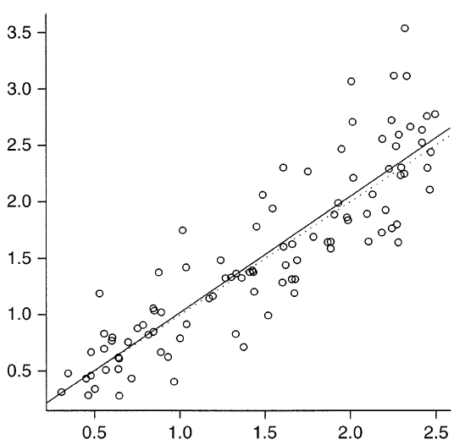
Classification of Detection Data
2. “Presence/absence” data
Think data used for classical logistic regression-type models (GLMs, GAMs, GLMMs, etc.)
Can get at probability of occupancy
Can’t (well, yes-can, but under strict parametric assumptions only; See Lele-Keim-Solymos work and DM Occupancy Model) estimate detection probability

Slide 17
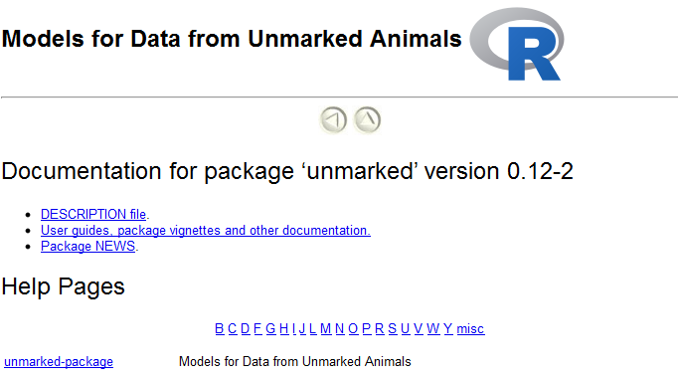
Classification of Detection Data
3. “Presence/absence” data with replication
Focus of this course
Allows estimation of both occupancy and detection probability
See Kèry 2002

Slide 18
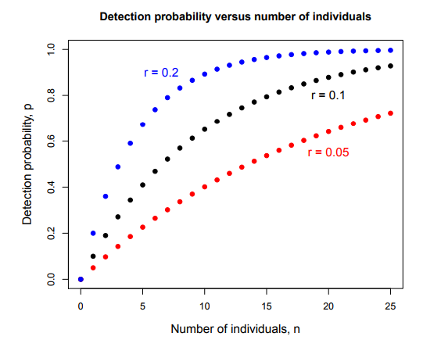
Classification of Detection Data
4. Count data
Detection/nondetection data is a summary of count data
(N) 0,0,1,3,1,4,2,5,...
Count data replicated in time can be modelled under N-mixture model (aka RN model; see Royle et al. 2005)
Can be used for species distribution models

Slide 19

Occurrence
Q. What is it?
“A binary state variable, indexed by space or time. It’s a sample because you couldn’t survey the entire area.
Problem: Detection is imperfect

Slide 20
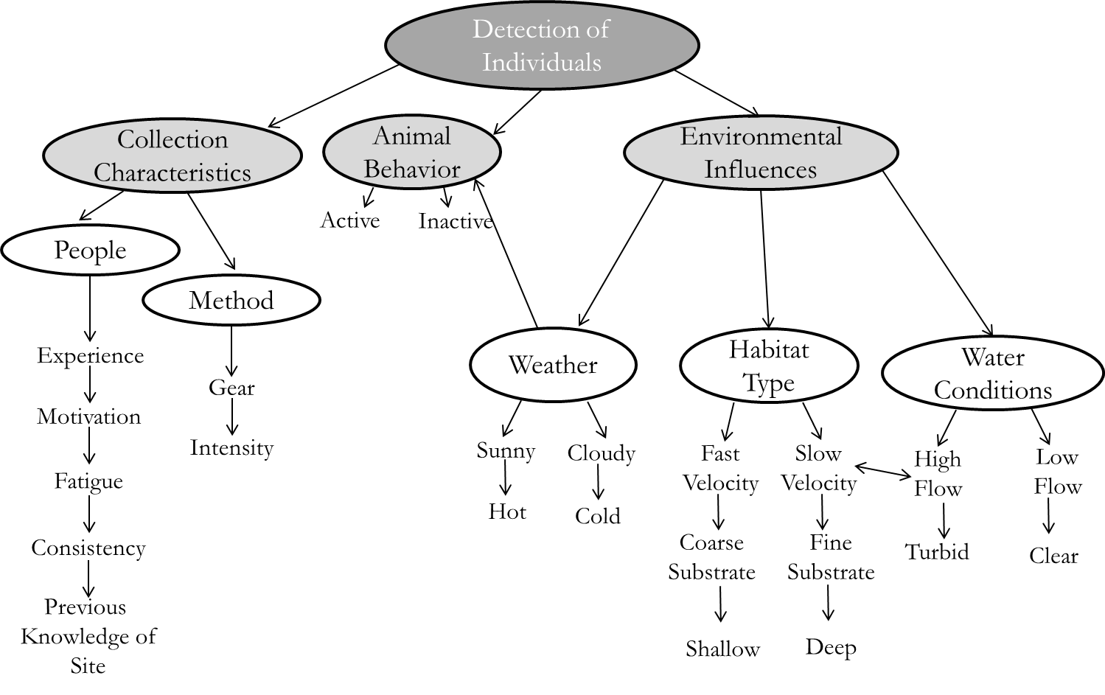
Factors Influencing Detection

Slide 21
Occupancy and Detection Probability
A few seminal papers on occupancy with imperfect detection
MacKenzie et al., 2002. “Estimating site occupancy rates when detection probabilities are less than one”
Tyre et al., 2003. “Improving precision and reducing bias in biological surveys: Estimating false negative error rates”
Gu & Swihart 2002. “Absent or undetected? Effects of non-detection of species occurrences on wildlife-habitat models”

Slide 22
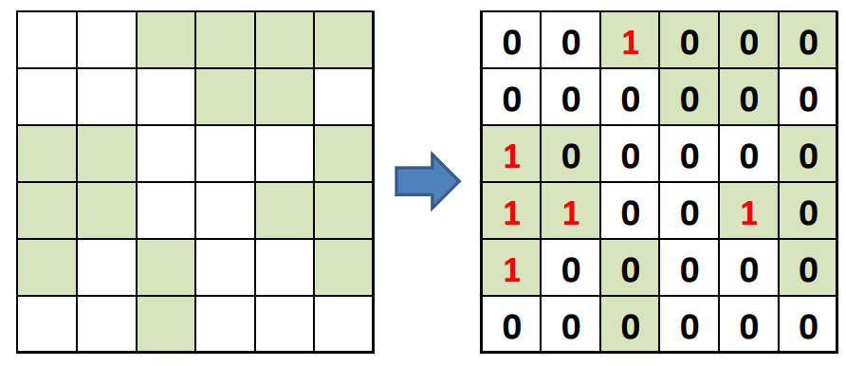
Sampling: imperfect detection
Effects of imperfect detection: underestimate occupancy
Estimated occupancy = true occupancy * detectability

Slide 23
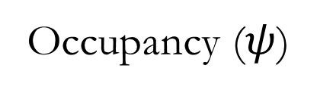
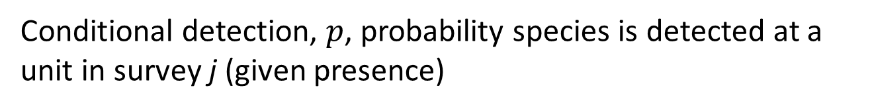
Occupancy Estimation
Occupancy ($ψ$)
Usually expressed as proportion or percentage
Can be modeled as a function of covariates
Habitat characteristics
Time
Conditional detection, $p$, probability species is detected at a unit in survey j (given presence)
Can be modeled as a function of covariates
Sample unit characteristics
Sampling method
Species characteristics

Slide 24

Probability of Occurrence
Probability is an a priori expectation – e.g. probability of heads on a coin toss
Proportion is the realization of the expectation – proportion of heads in 10 coin tosses

Slide 25
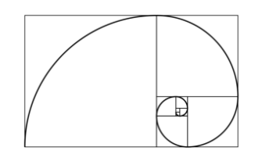

Occupancy Estimation
Primarily interested in the proportion of sites that are occupied or the probability a particular site is occupied.
Occupancy approach allows us to model variation in occupancy and detection simultaneously, relative to site-specific covariates

Slide 26


Slide 27
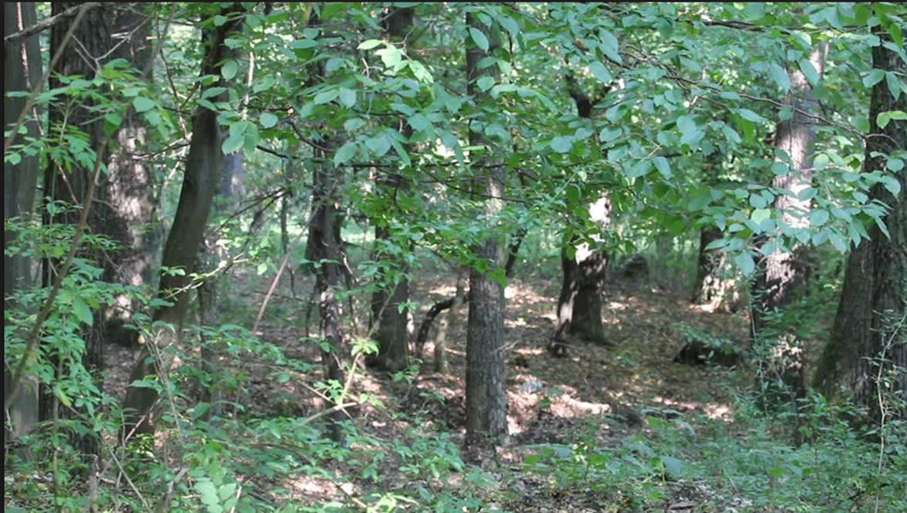
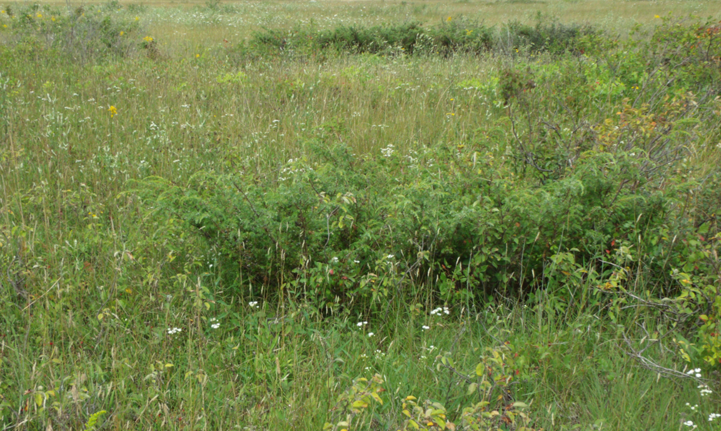
Raccowl surveys – 10 sites visited

Slide 28
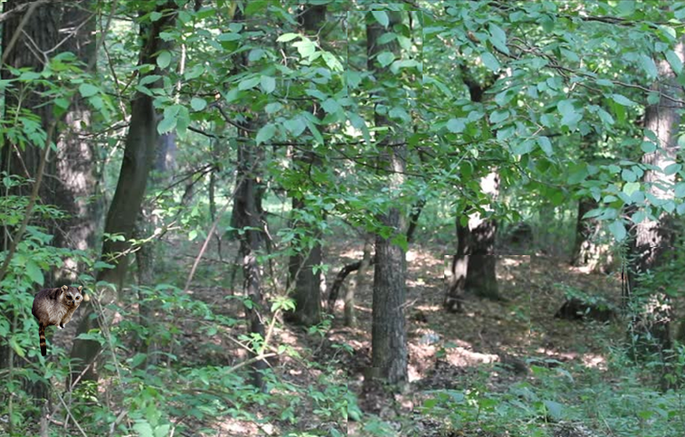
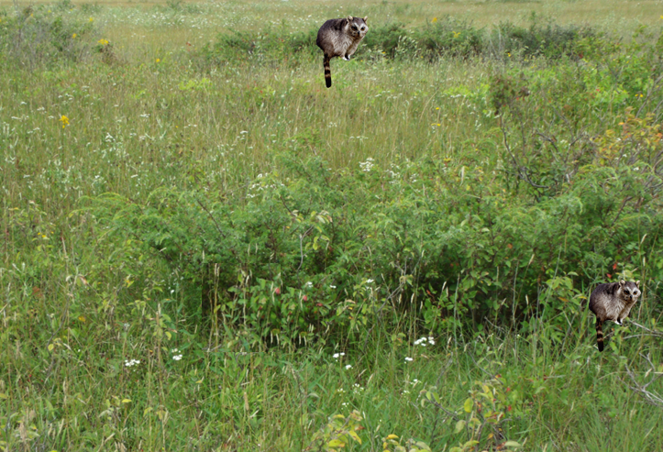
Raccowl Survey Results

Slide 29
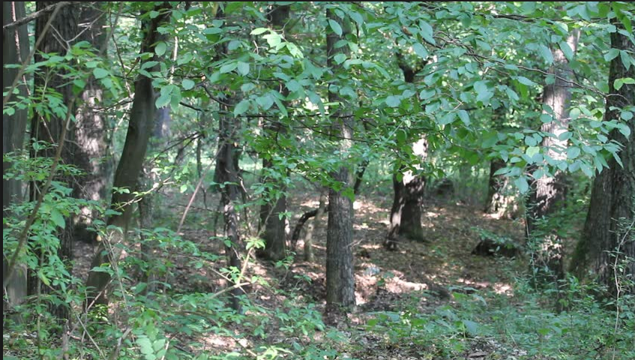

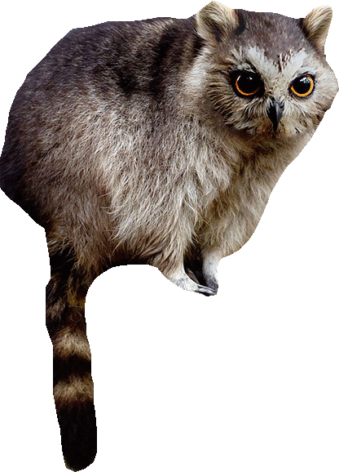





Slide 30



Slide 31
What is the proportion of sites occupied? What would be the naïve occupancy estimate?

Slide 32

Summary
Failing to account for imperfect detection can lead to spurious associations

Slide 33
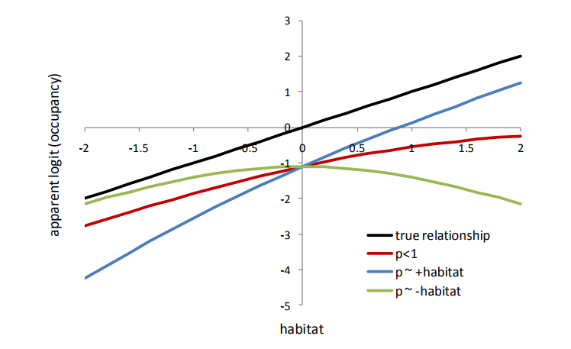
Occupancy Estimation and Modelling: Inferring Patterns and Dynamics of Species Occurrence (MacKenzie et al. 2006)
- Effects of imperfect detection: obscure relationships of occupancy with covariates

Slide 34

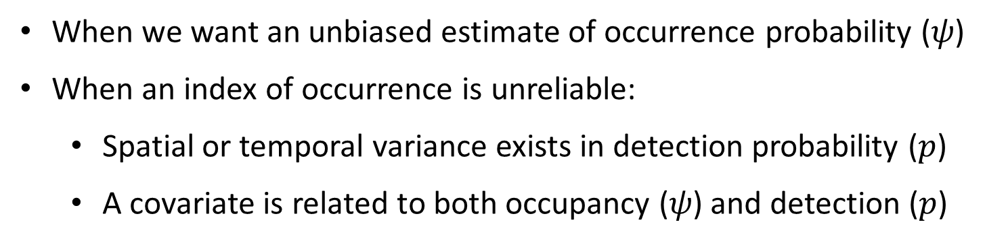
When Does (Incomplete) Detection Matter?
When we want an unbiased estimate of occurrence probability ($ψ$)
When an index of occurrence is unreliable:
Spatial or temporal variance exists in detection probability ($p$)
A covariate is related to both occupancy ($ψ$) and detection ($p$)

Slide 35
Activity
Read: “1. Article Discussion.docx”
Kellner & Swihart, 2014,
“Accounting for Imperfect Detection in Ecology: A Quantitative Review”
Groups:
-After reading, get into groups and discuss article. There are thought questions on the sheet to get your started.
-We’ll discuss as a class after 10 minutes of group thought.

Slide 36
Activity Summary
Noteworthy conclusions?

Slide 37
Available Software
Maximum-likelihood based software
MARK (stand-alone program; can be called from R)
Presence (stand-alone program; can be called from R)
Unmarked (called from R)
Bayesian software
WinBUGS (no longer actively supported)
OpenBUGS (stand-alone program; can be called from R)
JAGS (called from R)

Slide 38
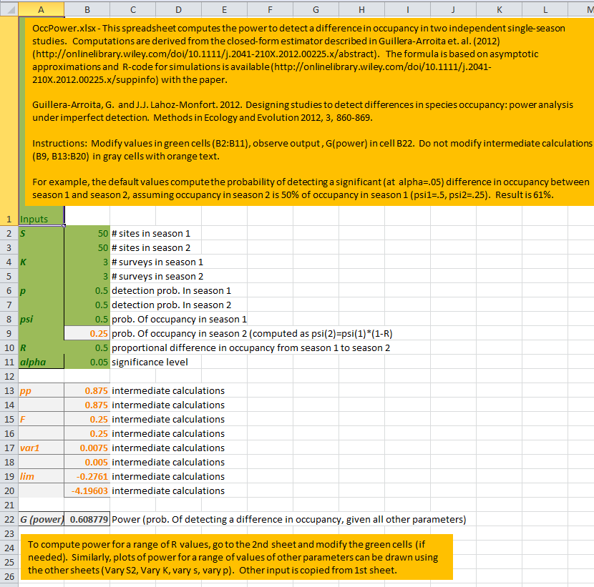
Available software
OccPower.xlsx - Spreadsheet to compute power to detect difference in 2 independent occupancy estimates using asymptotic approximations described in Guillera-Arroita et. al. (2012).

Slide 39
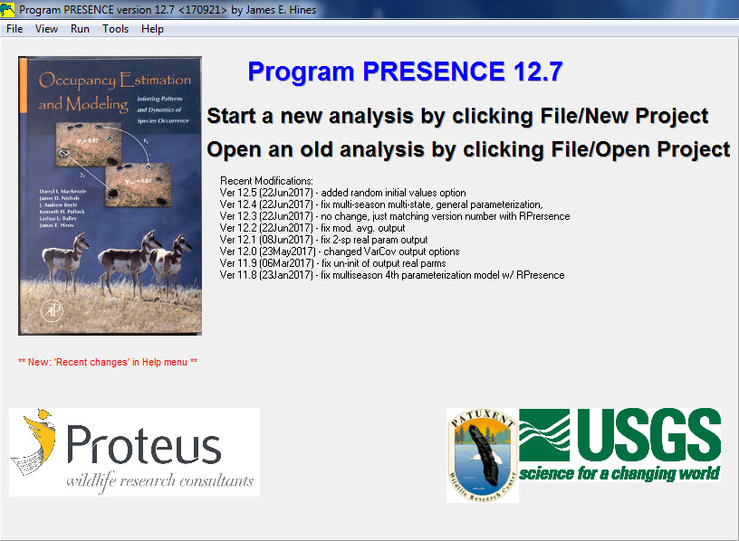

Slide 40
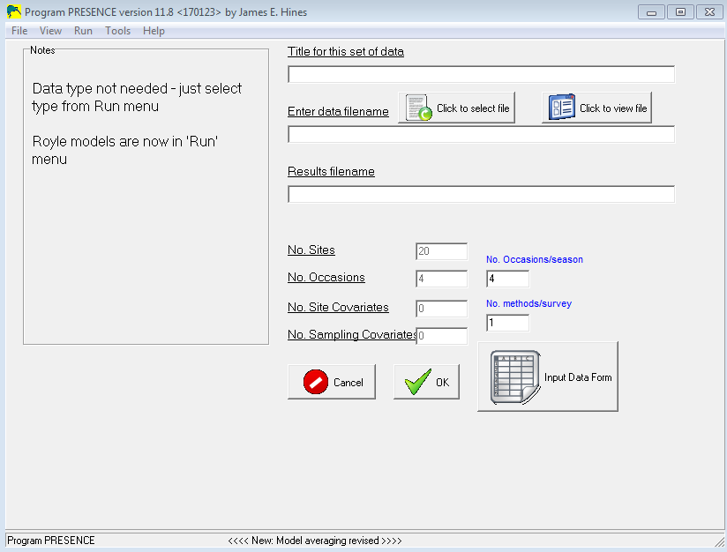
Available software
Presence-Estimates patch occupancy rates and related parameters
RPresence - Provides an R interface for running occupancy models available in Program PRESENCE plus some additional helpful routines.
https://www.mbr-pwrc.usgs.gov/software/presence.shtml

Slide 41
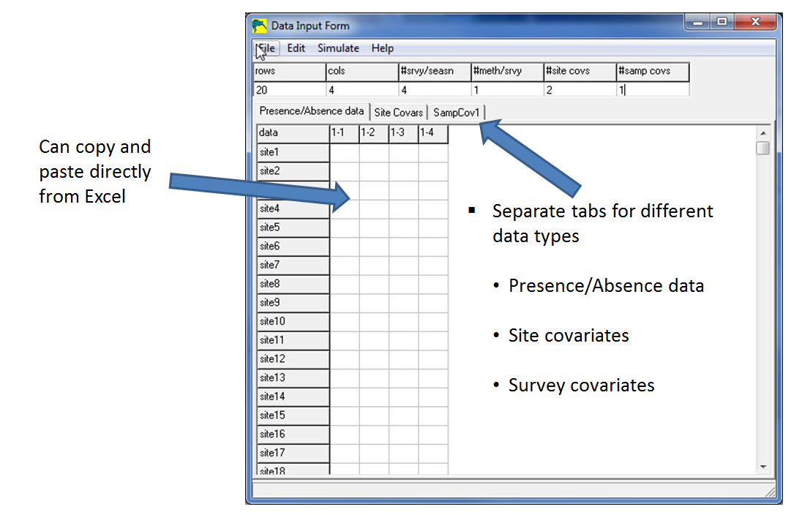
Presence

Slide 42
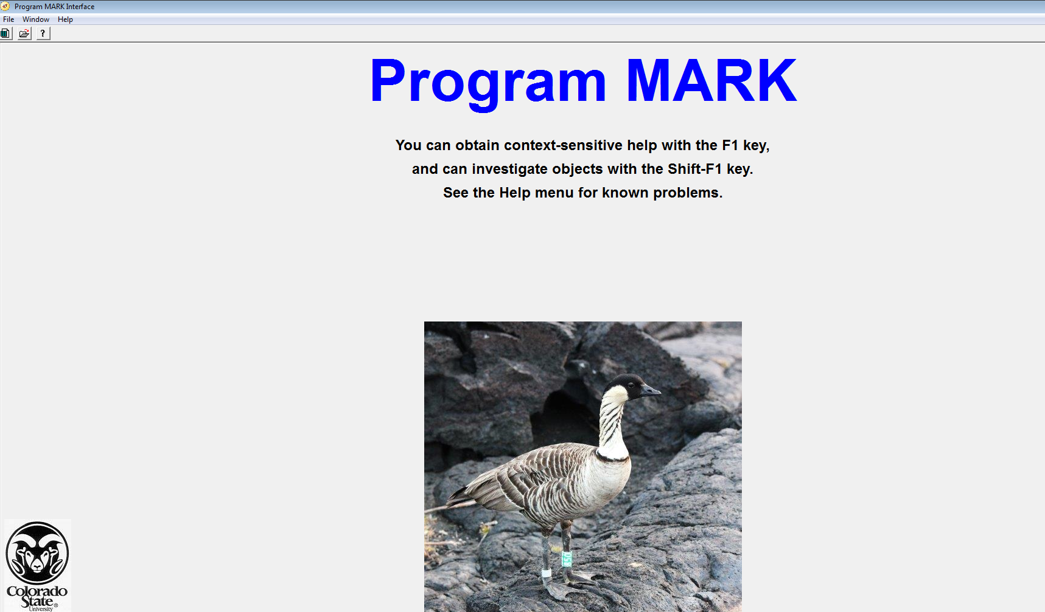
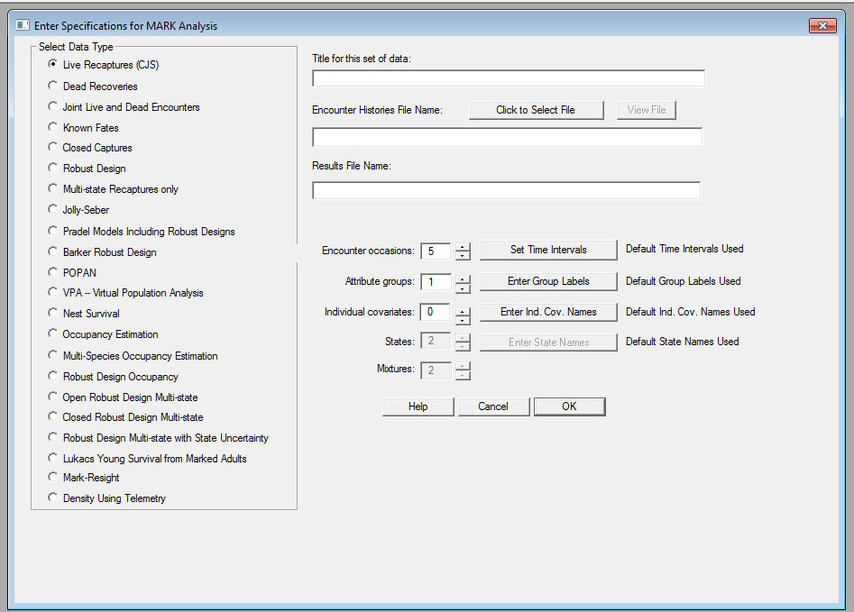
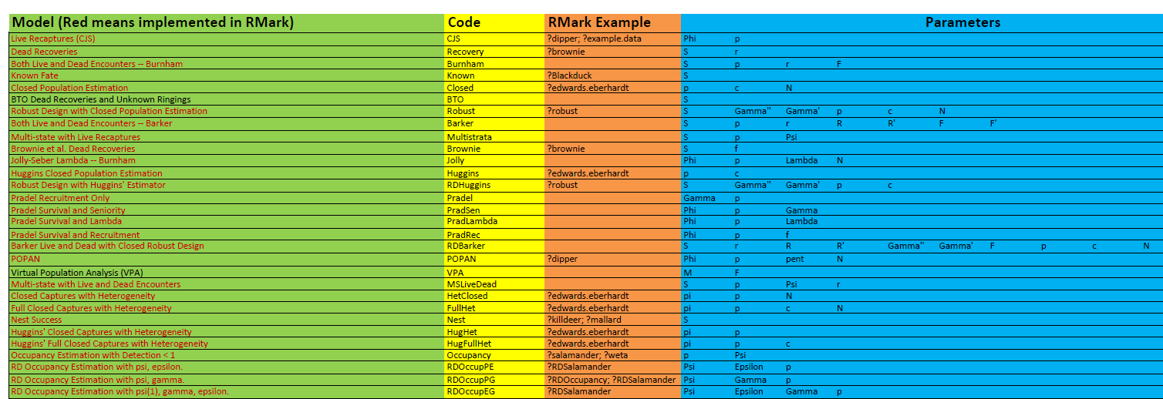
Available software
Mark- “ analysis of data from marked individuals”
RMark - Provides an R interface for running Mark models

Slide 43
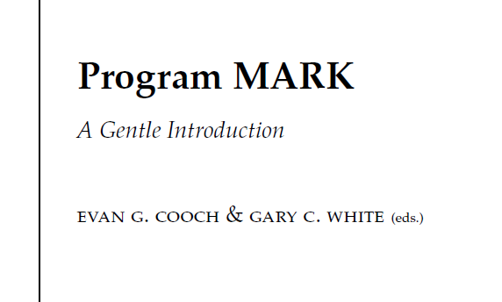

Slide 44
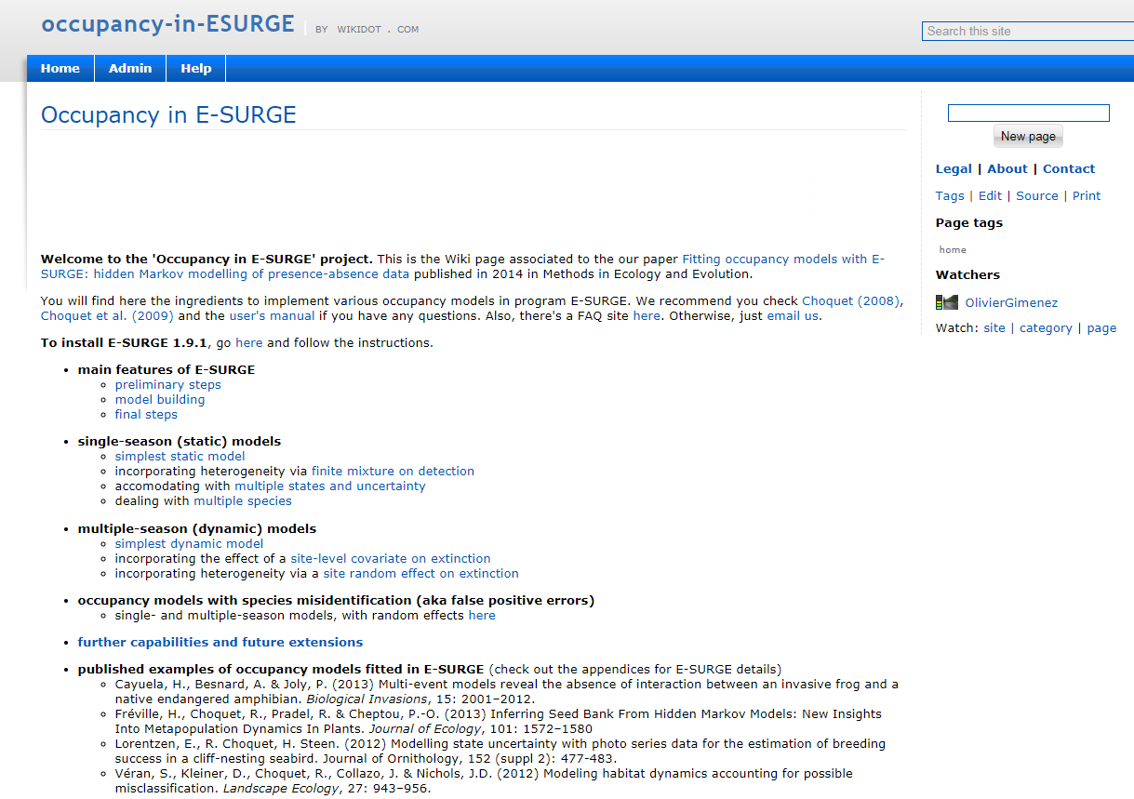
Occupancy in E-Surge
Hidden Markov modeling of detection-nondetection data
Maintained by CEFE- French Research Center for Ecology
1st: download Matlab
2nd: download E-surge

Slide 45
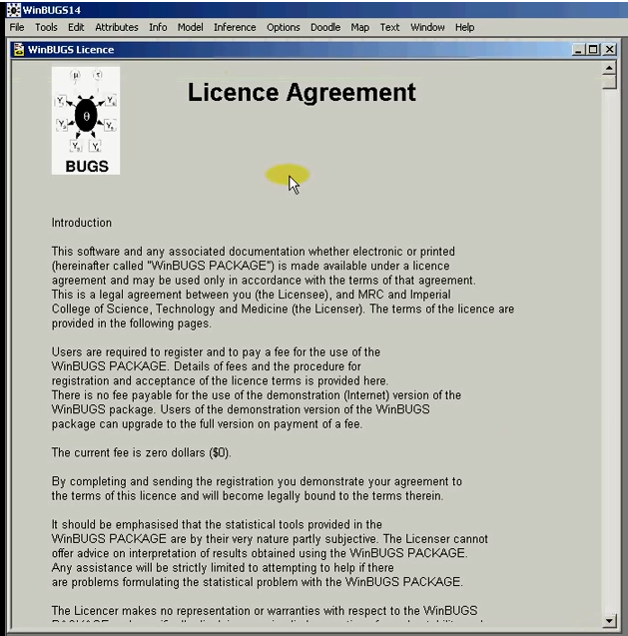
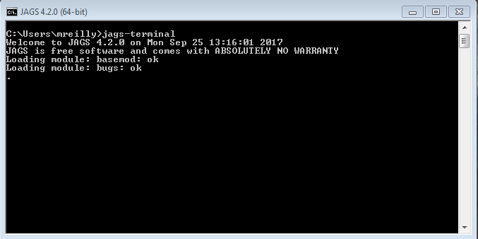
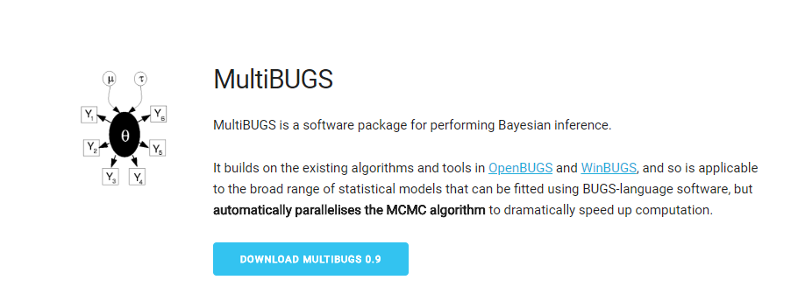
BUGS and JAGS
Bayesian models- using Gibbs sampling

Slide 46
Why R?
Pros
Vast package ecosystem
Individual extensions w/o asking permission
Unmatched graphics and charting capabilities
Cutting edge
Cons
Memory management
Speed
Efficiency
No web-app
Security
https://www.infoworld.com/article/2940864/application-development/r-programming-language-statistical-data-analysis.html
Notes:
https://www.infoworld.com/article/2940864/application-development/r-programming-language-statistical-data-analysis.html

Slide 47
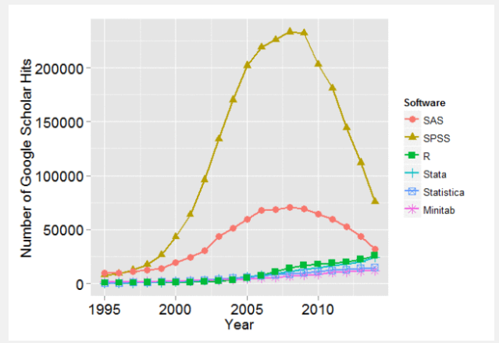
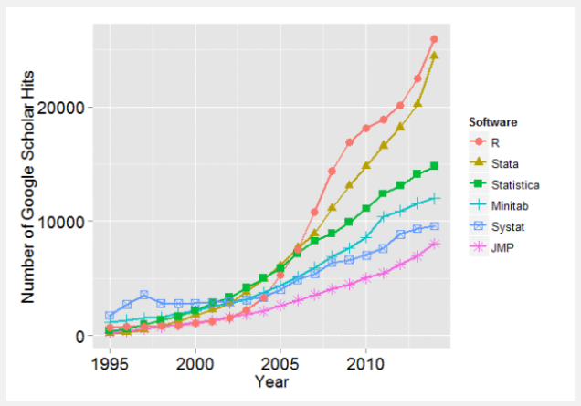
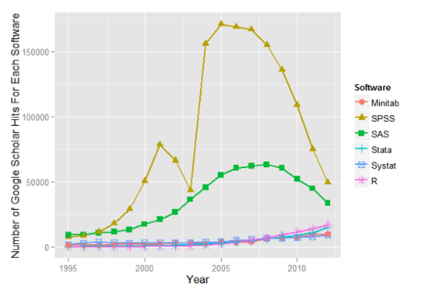
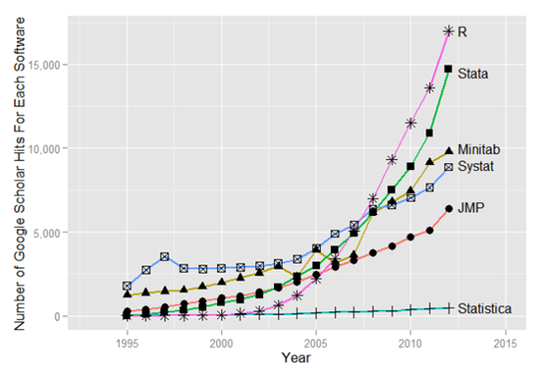
Why r?
Why use command line?

Slide 48
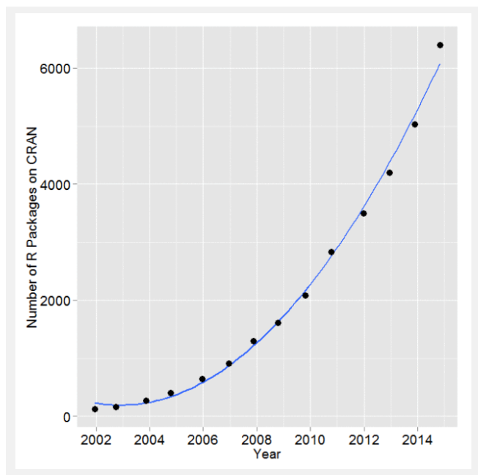
Growth in Capability
Number of R packages on CRAN for the last version released in each year
In 2014, R added 1,357 packages, counting only CRAN, or approximately 27,642 functions.
During 2014 alone, R added more functions/procs than SAS Institute has written in its entire history.

Slide 49
R Packages
CRAN Task View: Analysis of Ecological and Environmental Data
Installation of:
General packages
Modelling species responses and other data
Tree-based models
Ordination
Dissimilarity coefficients
Cluster analysis
Ecological theory (e.g., vegan)
Population dynamics (Rcaptrue, RMark, unmarked, SPACECAP, etc)
Environmental time series
Modeling population growth rates
Many more...
Notes:
https://cran.r-project.org/web/views/Environmetrics.html

Slide 50
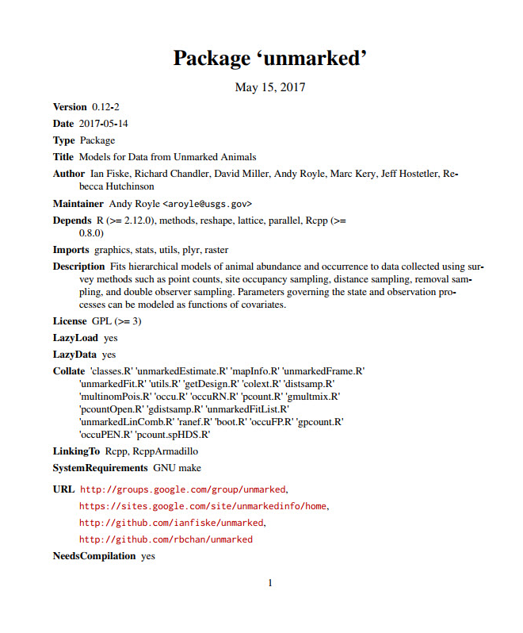

Slide 51
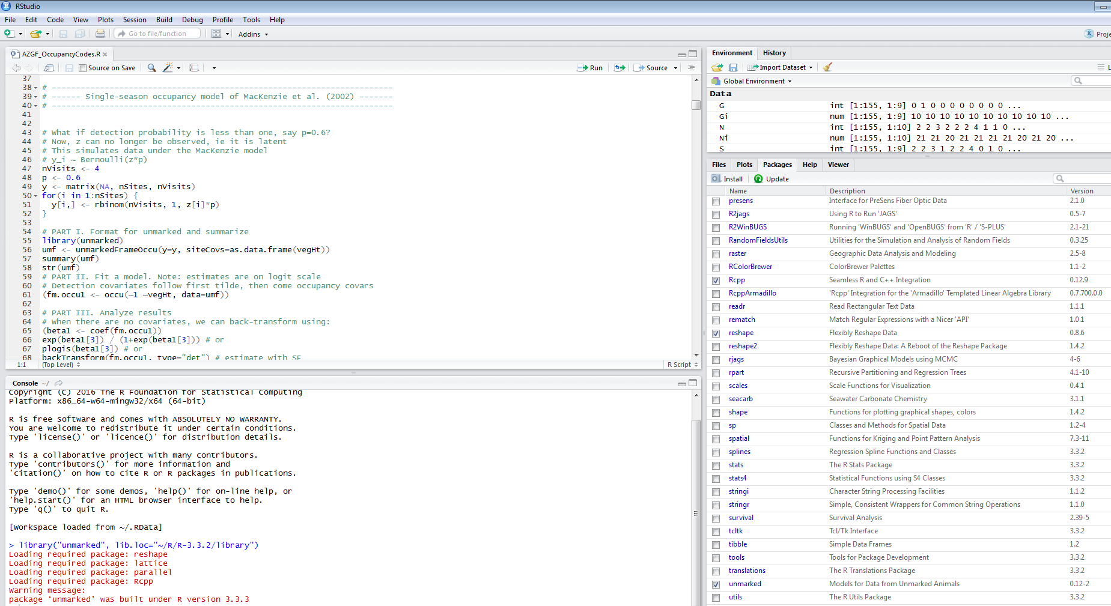
Available software
Unmarked- Package in R; hierarchical modelling framework

Slide 52
Available occupancy model types in MARK, Presence, and Unmarked as of November 2017
Occupancy Model Type | Presence | Unmarked | MARK
Single-season | ✓ | ✓ | ✓
Single-season-correlated-detections | ✓ |  | ✓
Single-season-multi-method/scale | ✓ | ✓ | ✓
Single-season-false-positive detections | ✓ | ✓ | ✓
Single-season-multi-state | ✓ |  | ✓
Single-season-two-species | ✓ |  | ✓
Single-season heterogeneity (Royle/Nichols) | ✓ | ✓ | ✓
Multi-season | ✓ | ✓ | ✓
Multi-season-false-positive detections | ✓ |  | ✓
Multi-season-multi-state | ✓ |  | ✓
Multi-season-two-species | ✓ |  | ✓
Royle-point-count | ✓ | ✓ | ✓
N-mixture |  | ✓
Robust Design N-mixture |  | ✓

Slide 53
Literature
Bayley & Peterson, 2001. “An approach to estimate probability of presence and richness of fish species”
Boyce & McDonald, 1999. “Relating populations to habitats using resource selection functions”
Brown & Maurer, 1989. “Macroecology: The division of food and space among species on continents”
Dail and Madsen,
Dorazio, 2012. “
Gu & Swihart, 2002. “Absent or undetected? Effects of non-detection of species occurrence on wildlife-habitat models”
Guillera-Arroita & Lahoz-Monfort, 2012. “Designing studies to detect differences in species occupancy: power analysis under imperfect detection”
Hanski, 1998. “Metapopulation dynamics”
Hastie and Fathian 2013. “Inference from presence-only data; the ongoing controversy”
He & Gaston, 2000. “Occupancy-abundance relationships and sampling scales”
Kéry, 2002. “Inferring the absence of a species - A case study of snakes”
Levins, 1969. “Some demographic and genetic consequences of environmental heterogeneity for biological controls”
MacKenzie et al., 2002. “Estimating site occupancy rates when detection probabilities are less than one”
Moilanen, 2002. “Implications of empirical data quality to metapopulation model parameter estimation and application”
Royle et al. 2005. “Modelling occurrence and abundance of species when detection is imperfect”
Royle et al. 2012. “Likelihood analysis of species occurrence probability from presence-only data for modelling species distributions”

